Slide 1
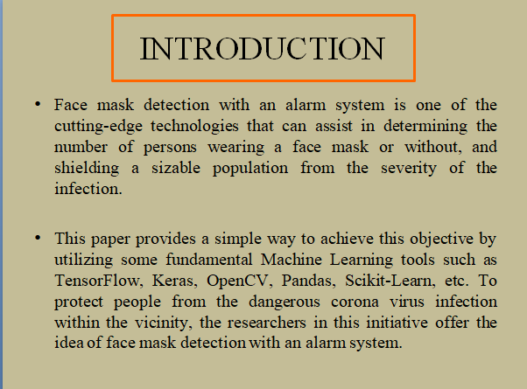
E
Enhancing Covid-19
Defense Matrix Parameters
F
D
using AI Face Mask
G
Detection Alarm System
C
B
H
A
AMBOANG, JYRESA MAE
AGOPITAC, CRISHELLE
GIGATARAS, FRANCES NICOLE

Slide 2
INTRODUCTION
Face mask detection with an alarm system is one of the cutting-edge technologies that can assist in determining the number of persons wearing a face mask or without, and shielding a sizable population from the severity of the infection.
This paper provides a simple way to achieve this objective by utilizing some fundamental Machine Learning tools such as TensorFlow, Keras, OpenCV, Pandas, Scikit-Learn, etc. To protect people from the dangerous corona virus infection within the vicinity, the researchers in this initiative offer the idea of face mask detection with an alarm system.

Slide 3
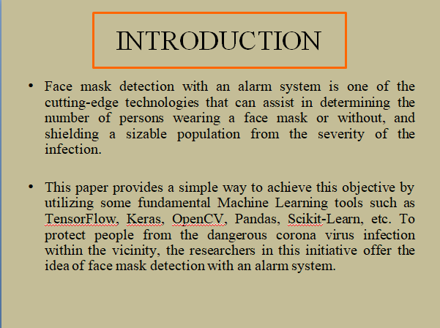
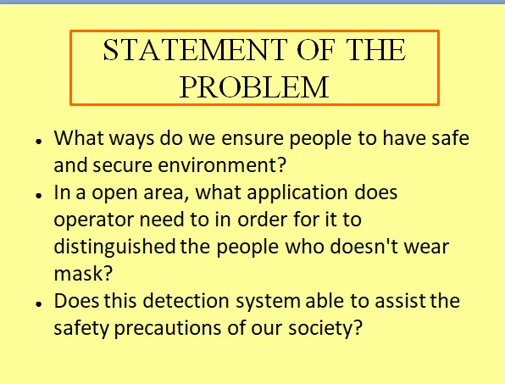
E
F
D
G
C
B
H
A

Slide 4
STATEMENT OF THE PROBLEM
How do we ensure people to have a safe and secure environment against COVID19?
How does the application benefit the operator in distinguishing people without mask?
How is this detection system able to assist the safety precautions of our society?
Notes:
2. How does the application benefit the operator in distinguishing people without mask
3. How do we ensure people to have a safe and secure environment against COVID19?
How does the application benefit the operator in distinguishing people without mask?
How is this detection system able to assist the safety precautions of our society?

Slide 5
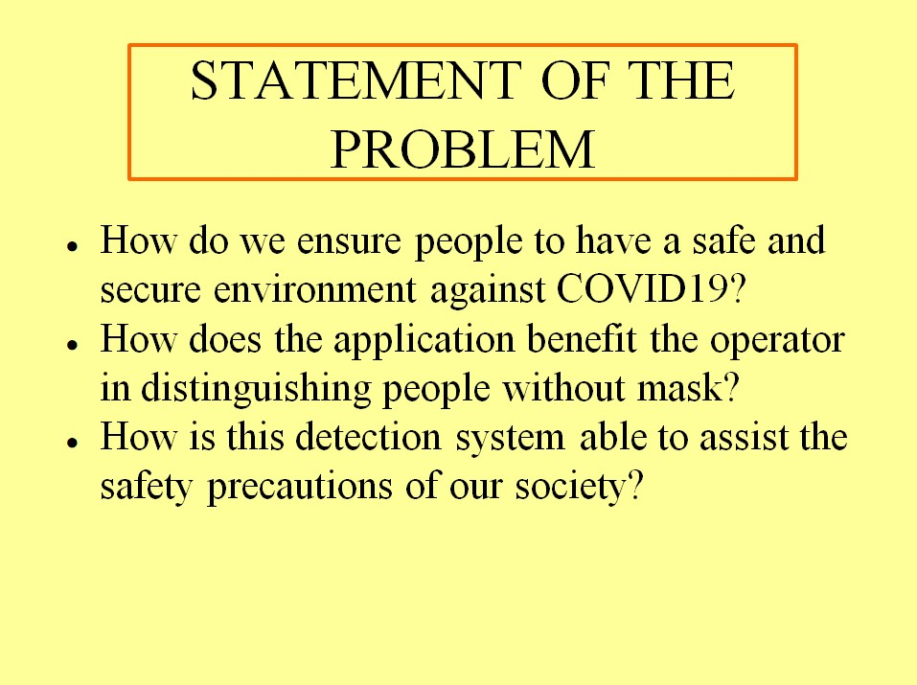
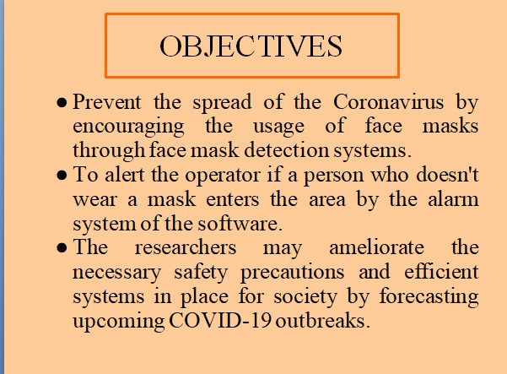
E
F
D
G
C
B
H
A

Slide 6
OBJECTIVES
The researchers aim to enhance the monitoring system of wearing face masks through a face mask detection program. It specifically aims to:
to design a Python-program monitoring system
to code a no-face mask recognition program
to embed no-face mask recognition with an alarm code

Slide 7
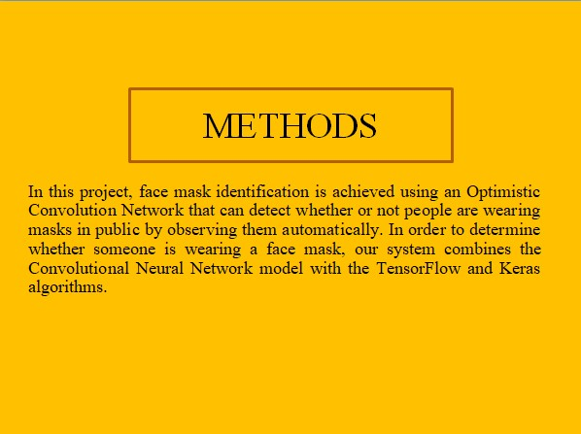
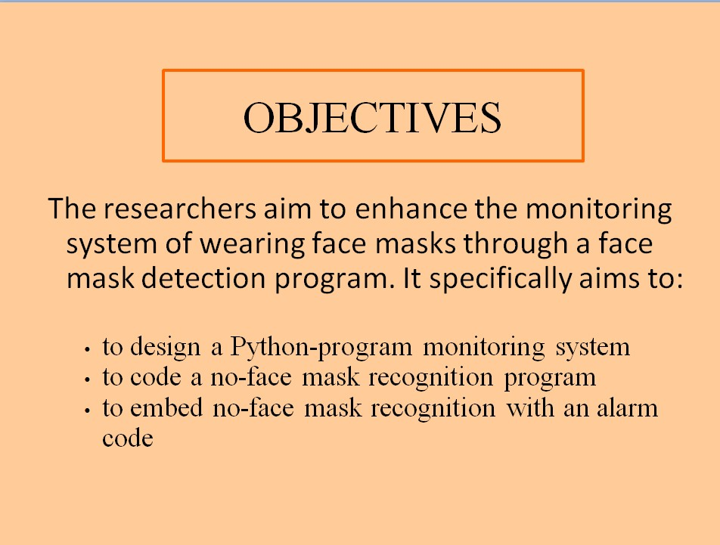
E
F
D
G
C
B
H
A

Slide 8
METHODS
In this project, face mask identification is achieved using an Optimistic Convolution Network that can detect whether or not people are wearing masks in public by observing them automatically. In order to determine whether someone is wearing a face mask, our system combines the Convolution Neural Network model with the TensorFlow and Keras algorithms.

Slide 9
TRAIN FACE MASK DETECTOR
Load Dataset
Train Face Mask Classifier with Keras/Tensorflow
Serialize Face
mask classifier
APPLY FACE MASK DETECTOR
Load Face Mask
classifier from disk
Face detection from Video/Image
Extract Faces
Alarm
No Mask
Apply the mask classifier in each face to determine if Masked or No Mask
Show Result
Masked

Slide 10
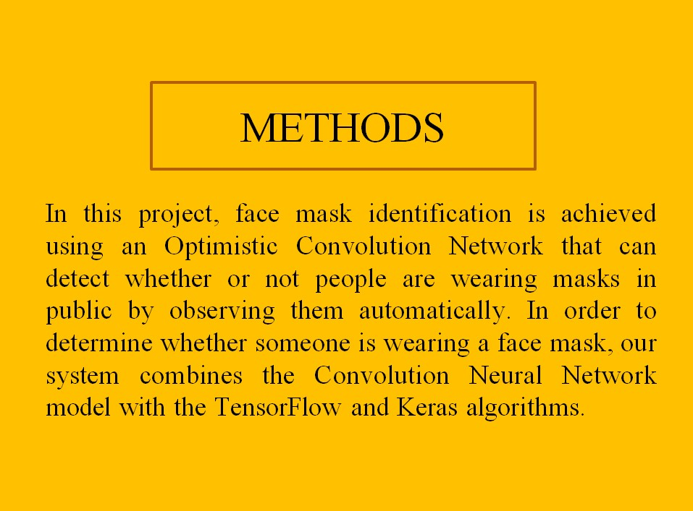
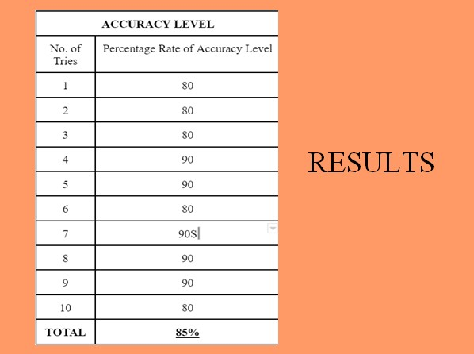
E
D
G
C
B
H
A

Slide 11
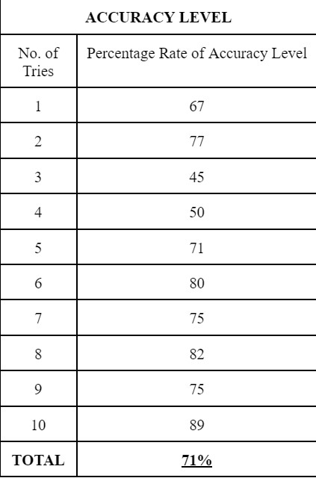
RESULTS
Notes:
Need supporting study of analysis tool
Need analysis tool
Chi square analysis

Slide 12
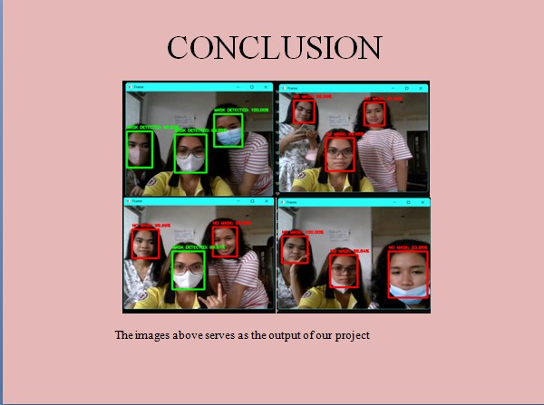
E
F
D
G
C
B
H
A

Slide 13
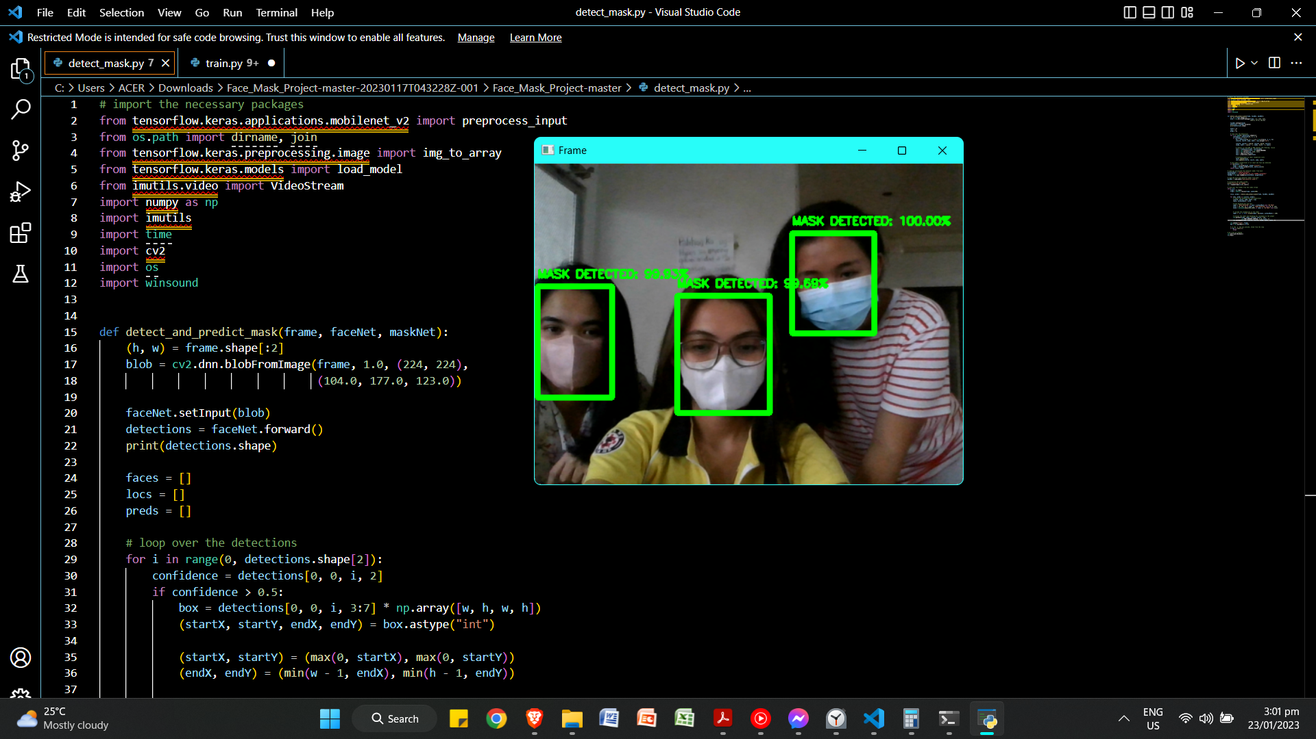
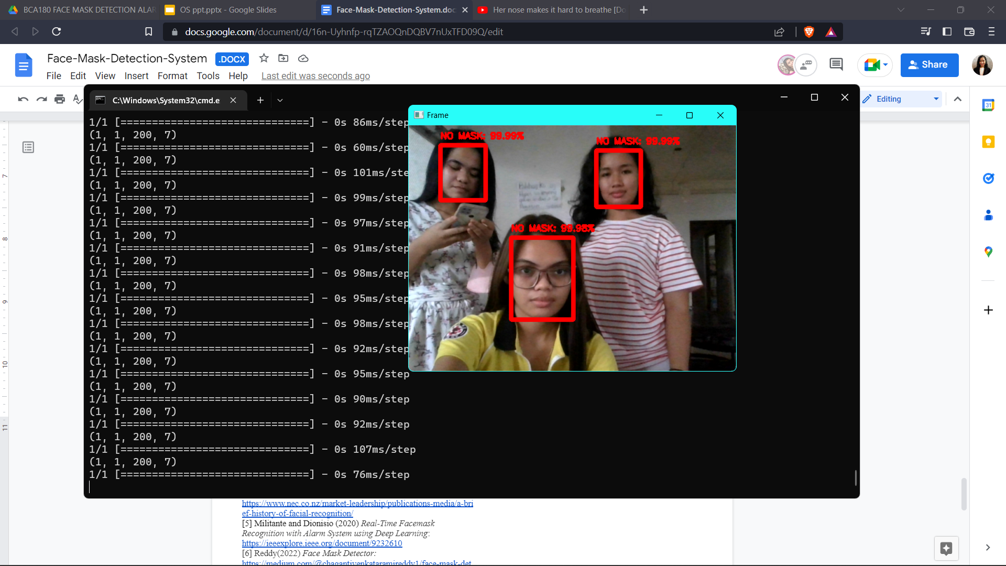
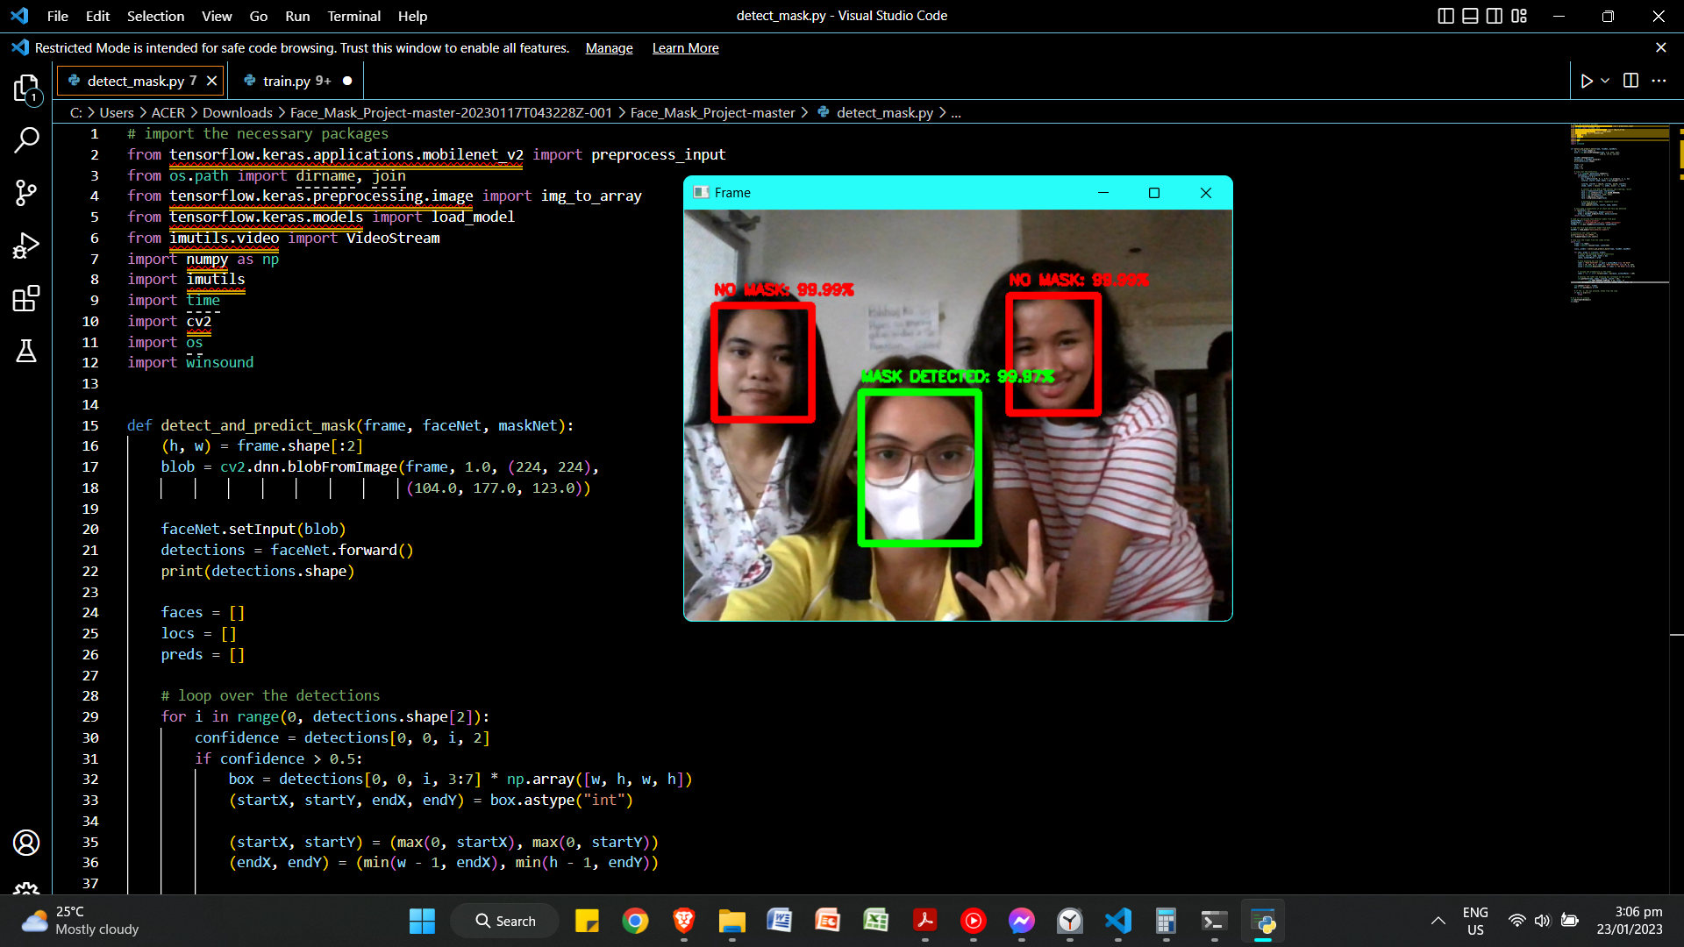
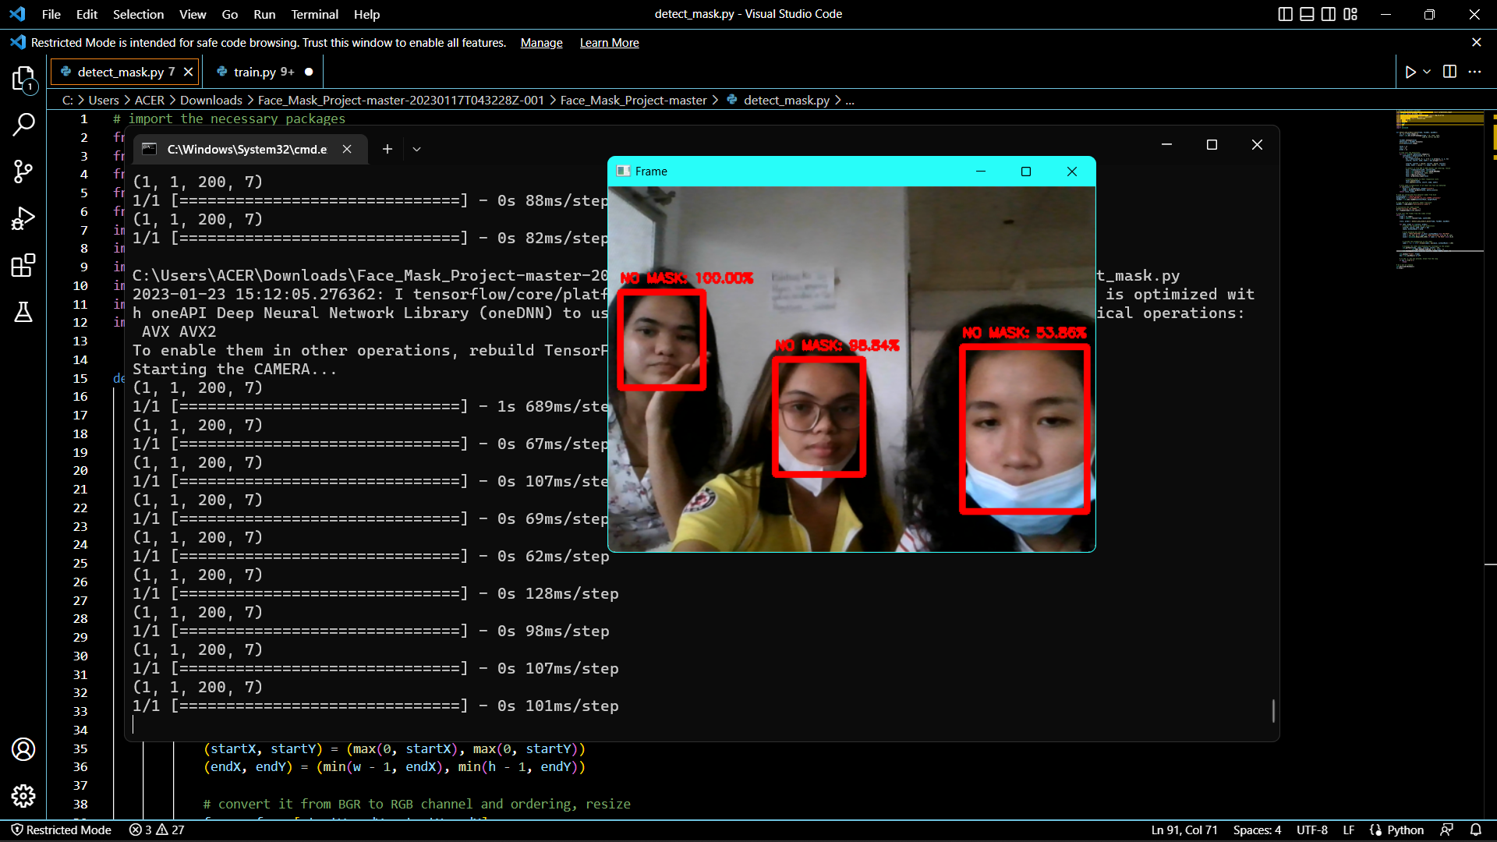
CONCLUSION
The images above serves as the output of our project.

Slide 14
CONCLUSION
The researchers results revealed that the no face mask recognition system encoded has an accuracy rate of 71%. According to studies, an accuracy of above 50% indicates that the device/program is effective for use. Since it 85%>50%, the program then satisfies this standard. Since the system is so sensitive to even little movements of the subject of the camera, there are times the alarm will function abnormally. The system also cannot detect if the person is wearing a mask if he/she is far from the camera. So the researchers concluded that the system is not 100% accurate and this project needs more improvements.
Notes:
The results revealed that the no face mask recognition system encoded has an accuracy rate of 85%. In the study of ___, () an accuracy of above 50% indicates that the device/program is effective for use. Since it 85%>50%, the program then satisfies this standard.

Slide 15
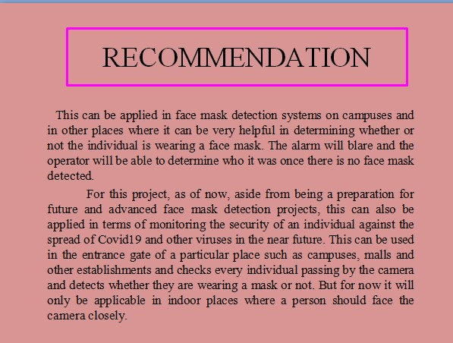
E
F
D
G
C
B
H
A

Slide 16
RECOMMENDATION
This can be applied in face mask detection systems on campuses and in other places where it can be very helpful in determining whether or not the individual is wearing a face mask. The alarm will blare and the operator will be able to determine who it was once there is no face mask detected.
For this project, as of now, aside from being a preparation for future and advanced face mask detection projects, this can also be applied in terms of monitoring the security of an individual against the spread of Covid19 and other viruses in the near future. This can be used in the entrance gate of a particular place such as campuses, malls and other establishments and checks every individual passing by the camera and detects whether they are wearing a mask or not. But for now it will only be applicable in indoor places where a person should face the camera closely.
Notes:
For further studies, the researchers would like to recommend the following:
1. enhance

Slide 17
E
F
D
G
C
B
H
A

